Slide 1
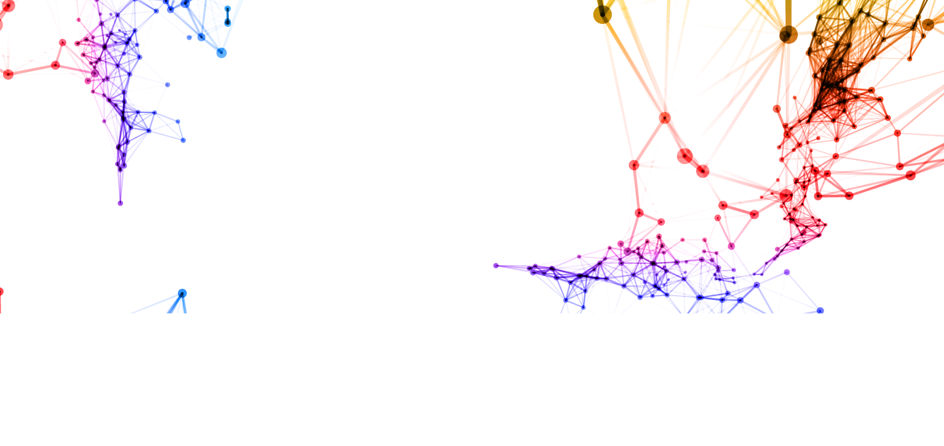
From Science to Data Science
seminar
#FStoDS
CRI Data Science Club
#FStoDS

Slide 2
CENTRE DE RECHERCHES INTERDISCIPLINAIRES
The CRI’s main role is to promote new educational techniques and strategies to empower the students to take initiative and develop their own research projects.
https://cri-paris.org
@criparis
#CRI
#FStoDS

Slide 3
FROM SCIENCE TO DATA SCIENCE
Meet PhD holders = > today data professionnals
career transition
data science
to volounteer or suggest speakers:
cri-data-science-club@googlegroups.com
#FStoDS

Slide 4
The club
We are 10 students from the CRI and outside (Licence, Master, PhD)
extracting knowledge from data
learning new tools of data analysis
sharing you experience with peers
exploring job possibilities related to data
meeting inspiring speakers from academia and industry
#FStoDS

Slide 5
In the Age of Data
Buzz words:
Machine Learning
Deep Learning
Data analysis
Big data
Python, R
Models
etc.
#FStoDS

Slide 6
JOIN US!
cri-data-science-club@googlegroups.com
cri-data-science-club.slack.com
with
@cri-paris.org
@curie.fr
@pasteur.fr
#FStoDS

Slide 7
PArtners
http://www.s2ds.org/
deadline: 2 April
#FStoDS

Slide 8
From Science to Data Science #1
18h30- 19h15 Nicolas Thiebaut
PhD Theoretical Physics => Quantmetry, Data Science Consultant
19h15-20h Luc Boruta
PhD Computational Linguistics => Thunken, CEO
20h-20h45 Stephane Senecal
PhD Signal processing => Orange, R&D Engineer/ Scientist
20h45-21h closing remarks
21h-23h buffet (lounge)
#FStoDS

Slide 9
Thank you
From Science to Data Science #2
16th May
Joseph Pellegino Kernix
Gilles Wainrib Owkin
Romain Laby Cisco
save the date!
#FStoDS

Slide 10
Thank you
All documents related to today event:
https://github.com/UrszulaCzerwinska/FromSctoDS/1
See you next time!
#FStoDS

